Slide 1

HackSys Extreme Vulnerable Driver
By Ashfaq Ansari (@HackSysTeam)

Slide 2
$whoami
Ashfaq Ansari
Security Consultant/Researcher @ Payatu Technologies Pvt. Ltd.
Interests
Vulnerability Research, Kernel Exploitation, Reverse Engineering, Exploit Development, Program Analysis, Malware Research, Web Security & Machine Learning
About Payatu
A boutique security testing company specializing in Iot, Mobile, Cloud - http://www.payatu.com
HackSys Extreme Vulnerable Driver - http://www.payatu.com/hacksys-extreme-vulnerable-driver/
Damn Insecure and Vulnerable App for Android - http://www.payatu.com/damn-insecure-and-vulnerable-app/
In-house Fuzz testing Infrastructure
Security training in Mobile and IoT exploitation – Blackhat, Brucon, Hack In Paris and Corporate trainings

Slide 3
What is HackSys Extreme Vulnerable Driver?
It is intentionally vulnerable Windows Kernel Driver developed for security enthusiasts to learn and polish their exploitation skills at Kernel level.
HackSys Extreme Vulnerable Driver caters wide range of vulnerabilities ranging from simple Buffer Overflow to complex Use After Free, Uninitialized Variable and Pool Overflow.
This allows the researchers to explore the different exploitation techniques for every implemented vulnerabilities.

Slide 4
Why is HackSys Extreme Vulnerable Driver?
No proper vulnerable driver to learn exploitation in Kernel mode
Lack of working exploits
No proper documentation
What about source code?
How do we mitigate the vulnerabilities?
HackSys Extreme Vulnerable Driver or HackSys Extreme Secure Driver?

Slide 5
Vulnerabilities Implemented
Pool Overflow
Use After Free
Stack Overflow
Type Confusion
Integer Overflow
Stack Overflow GS
Uninitialized Variable
Null Pointer Dereference
Arbitrary Memory Overwrite
HackSys Extreme Vulnerable Driver

Slide 6
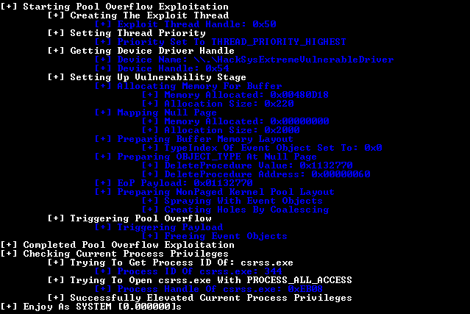
Exploitation – Pool Overflow

Slide 7
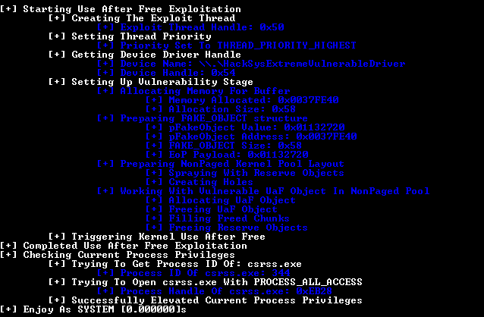
Exploitation – Use After Free

Slide 8
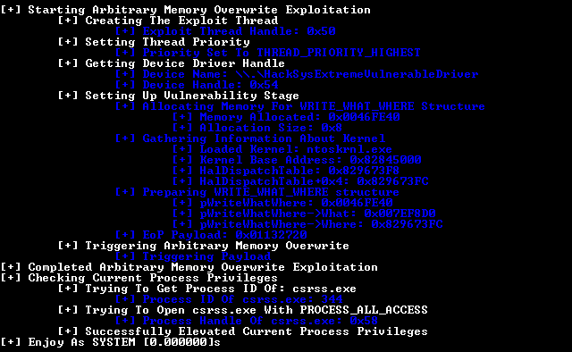
Exploitation – Arbitrary Overwrite

Slide 9
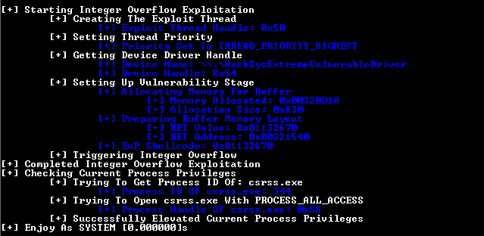
Exploitation – Integer Overflow

Slide 10
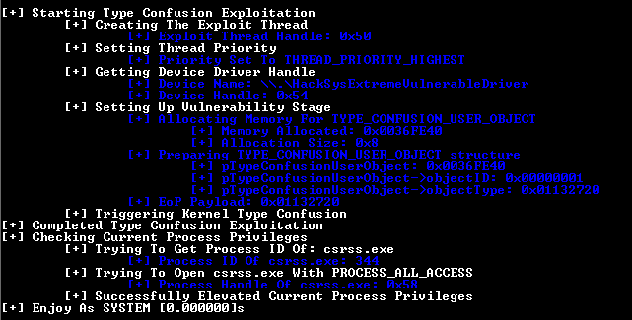
Exploitation – Type Confusion

Slide 11
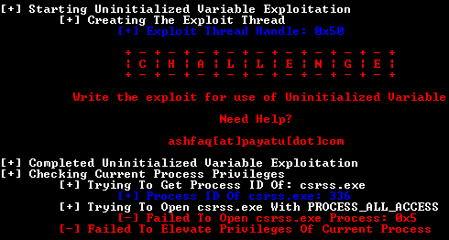
Exploitation – Challenge – Uninitialized Variable

Slide 12
References
Blog: http://www.payatu.com/hacksys-extreme-vulnerable-driver/
Source: https://github.com/hacksysteam/HackSysExtremeVulnerableDriver

Slide 13
Thanks!
Q & A
Reach me
ashfaq@payatu.com
@HackSysTeam
http://hacksys.vfreaks.com/
https://github.com/hacksysteam
http://null.co.in/profile/411-ashfaq-ansari

